Slide 1
Bread Sorter
Team Bread - Sorting Algorithm Visualizer
s1282003 Angelita Gozaly, s1282004 Zeke Sy, s1307017 Tuyet-My Pham

Slide 2
🍞 Introduction 🍞

Slide 3
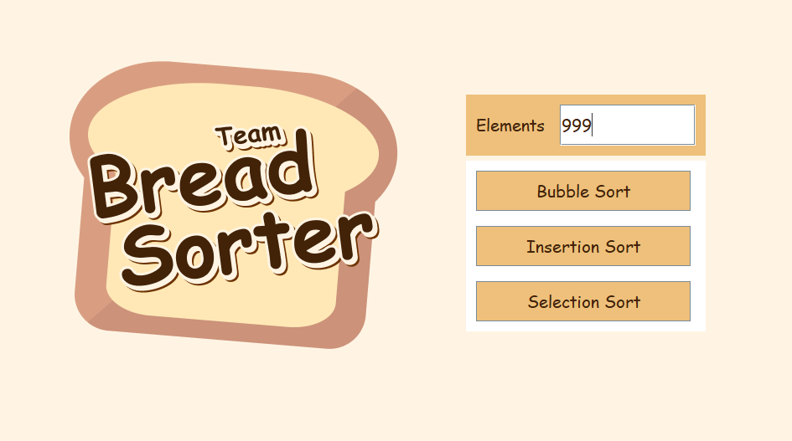
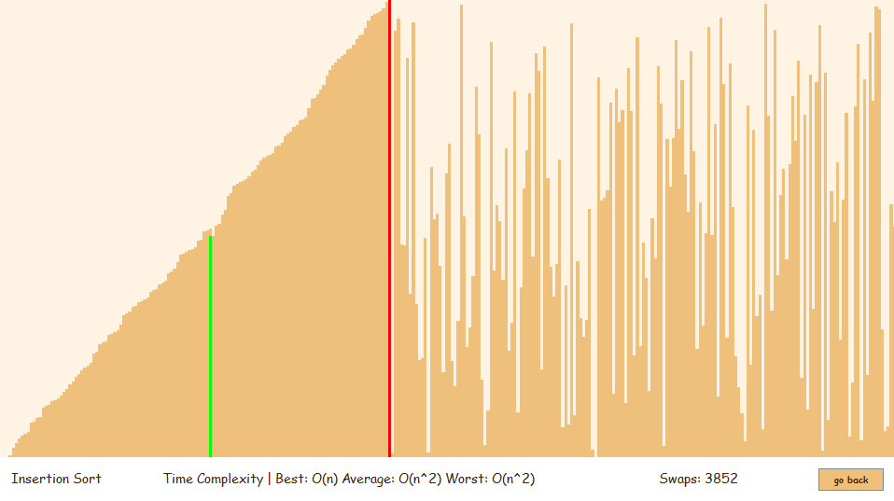
Bread Sorter
Selection Screen
Visualizer Screen

Slide 4
🍞 Design 🍞

Slide 5
Goals
Approachable
Educational

Slide 6
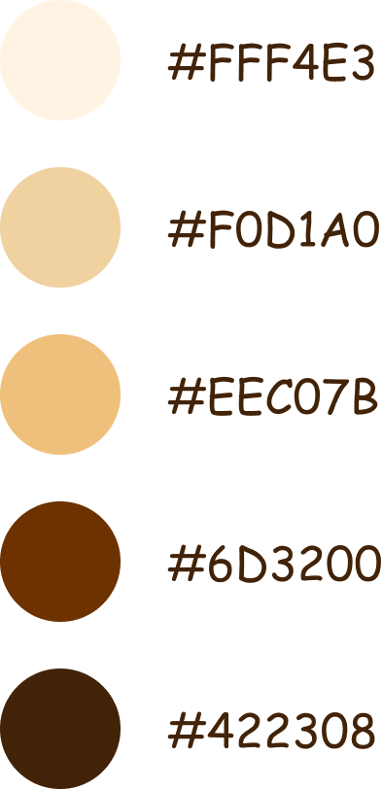
Theme
Comic Sans MS

Slide 7
🍞 Selection Screen
Element Number
Algorithm Buttons

Slide 8
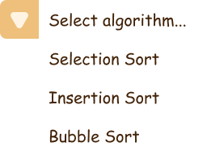
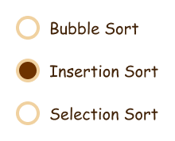
Problems of Buttons
Solution
Dropdown Menu
Not as easy to add algorithms
Change to different selection menu
Radio Buttons

Slide 9
🍞 Visualizer Screen
Visualizer
Name of Algorithm
Time Complexity
Swap Counter
Back Button

Slide 10
🍞 Timeline 🍞

Slide 11
🍞 Timeline
DEC
DEC
JAN
JAN
Initial planning
Problem with Visualizer
Inflexible structure and code
Unorganized code

Slide 12
🍞 Timeline
DEC
DEC
JAN
JAN
Initial planning
Problem with Visualizer
Inflexible structure and code
Unorganized code

Slide 13
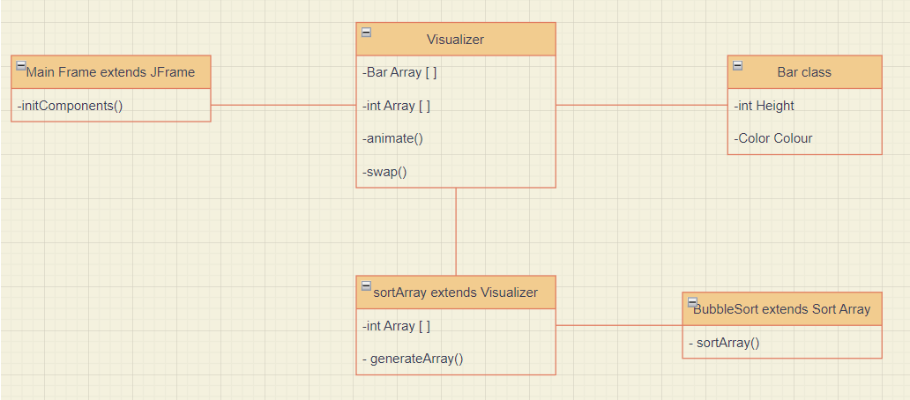
Initial planning

Slide 14
🍞 Timeline
DEC
DEC
JAN
JAN
Initial planning
Problem with Visualizer
Inflexible structure and code
Unorganized code

Slide 15
Problem with Visualizer
Java Swing Bar class
How drawing things with Java Swing worked
repaint() function

Slide 16
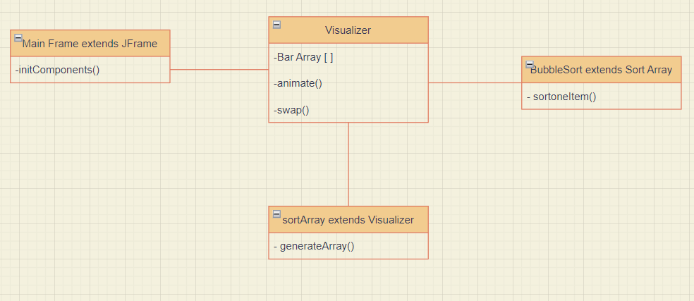

Slide 17
🍞 Timeline
DEC
DEC
JAN
JAN
Initial planning
Problem with Visualizer
Inflexible structure and code
Unorganized code

Slide 18
Inflexible structure and code
Doesn’t utilize the advantages of OOP
Adding new sorts isn’t easy
Basically all the code can be put in one file

Slide 19
🍞 Timeline
DEC
DEC
JAN
JAN
Initial planning
Problem with Visualizer
Inflexible structure and code
Implemented Design

Slide 20
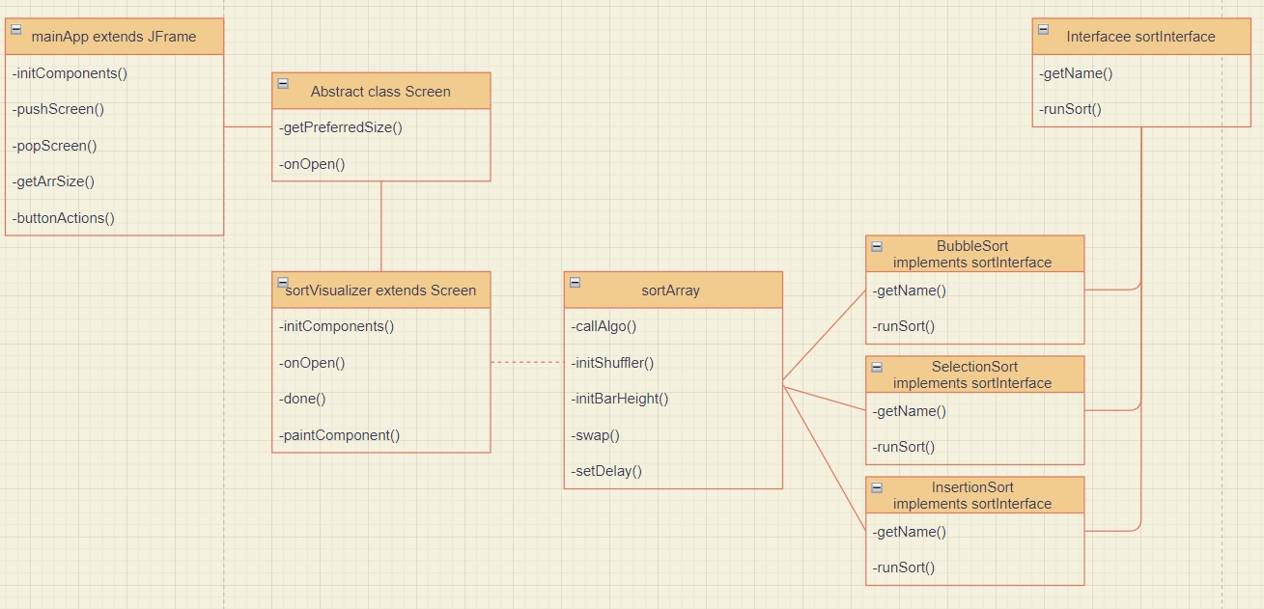
Implemented Design

Slide 21
Demonstration

